Slide 1
BELLEVUE SISTER CITIES ASSOCIATION celebrates 20 years of friendship Bellevue, WA and Liepaja, Latvia

Slide 6
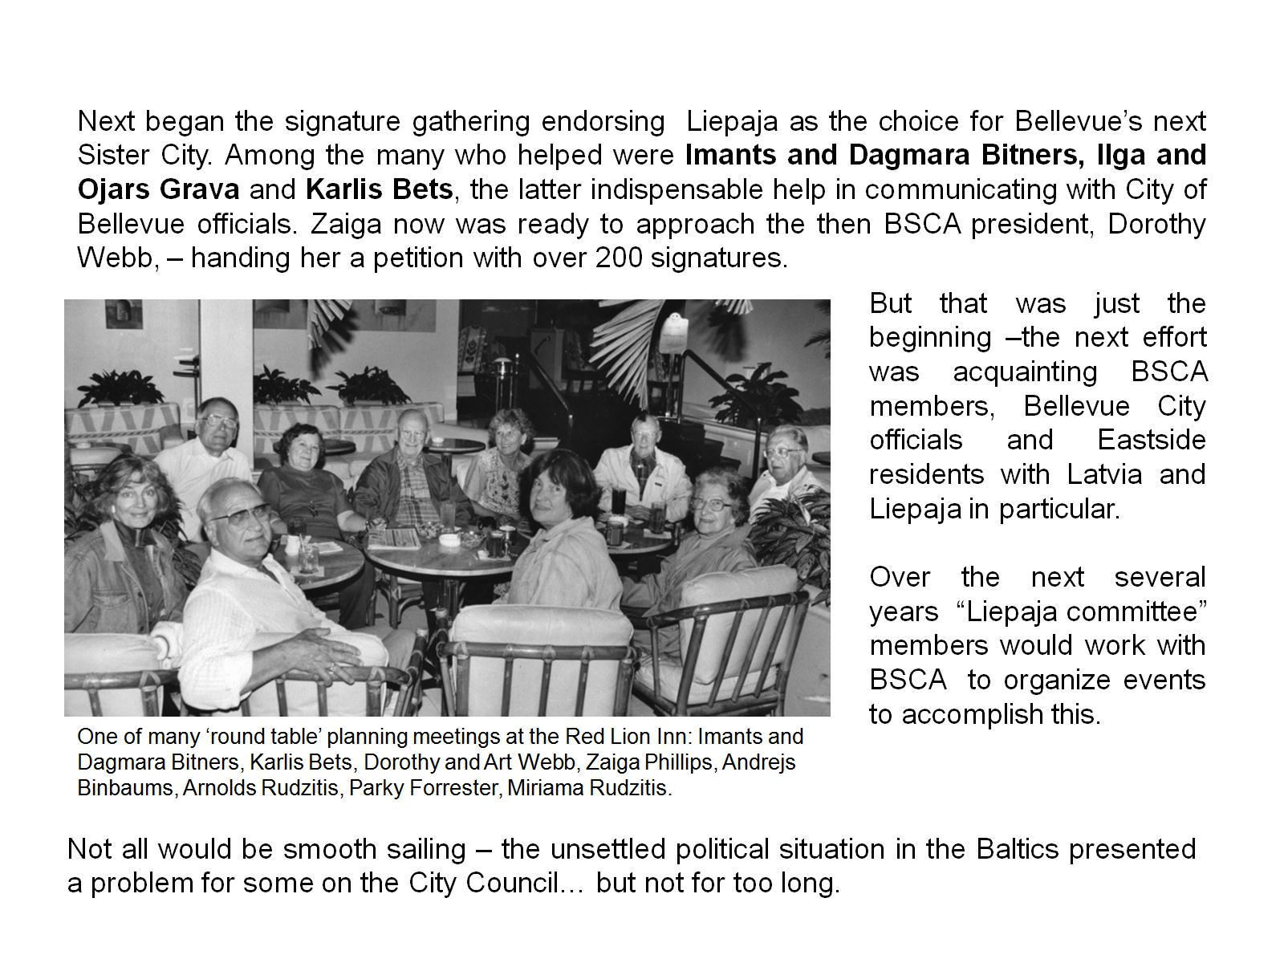

Slide 21
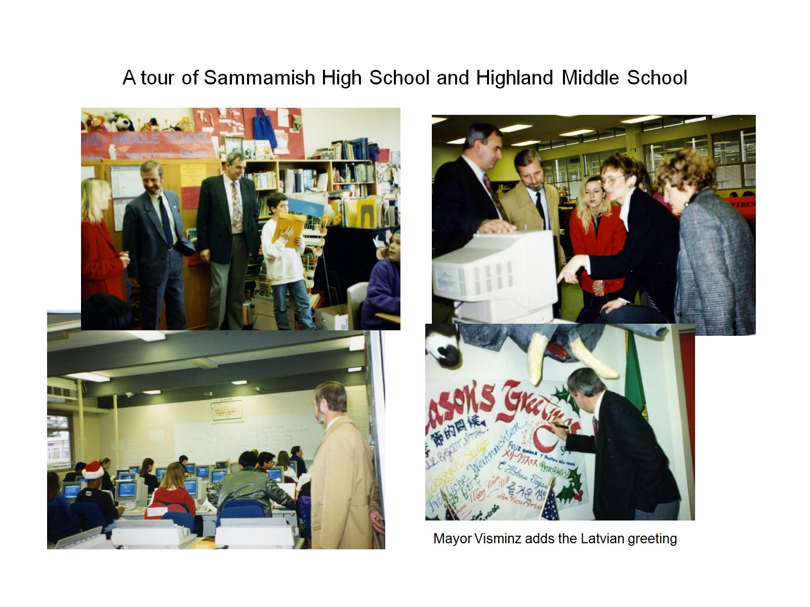

Slide 23
